Slide 1
Loan Approval Prediction
Team 6 - Titans
Jennifer Nghi Nguyen
Ayush Wattal
Mohini Patil
Ritu Bhamrah

Slide 2
Introduction
According to the Federal Reserve (Spring 2021), American household debt has reached $14.6 trillion.
According to CNBC 2021 report, the average American has $90,460 in debt.
In 2007, subprime mortgage was one of the major cause of recession in past.
Loaning money is a crucial part of banking system from which banks generates money in the form of interest
The interest on principal amount is key factor for banks’ performance.
It is very important for the banks to understand payback capacity of the loaner before approving a loan.
Notes:
(house loans, education loans, personal loans)

Slide 3
Introduction (cont.)
Factors for Loan approval prediction:
Applicants and co applicants income
Marital status, Number of dependents
Credit history
Loan amount
Self employment
The User for this model will be Banks, Common Public(Loan Requester).

Slide 4
Objectives
Predict the Loan approval status based information - Gender, Credit history, Marital status, Number of dependents, loan amount, etc.
Data exploration with multiple EDA tools and data transformation.
Deliver the best model to predict whether the loan should be approved or not.
Python code used for predictive analytics for various machine learning models.
Model validation performed on various models.
Summary report explaining approaches used for project and reasoning of the best resulting model.

Slide 5
Methodology
01
02
Business Understanding
Data Exploration
03
04
Data Modeling
Evaluation
Understand the objectives & determine scope
Data exploration, Data Cleaning using Python, Data transformation
Create Training and Testing sets,
Run different models
Evaluation of different models

Slide 6
Data Exploration
Visualize the data and check for data issues.
Handle the data issues.
Check if any field is not required and can be dropped before modelling phase
Data quality report
Analytics Base Table
Data transformation

Slide 7
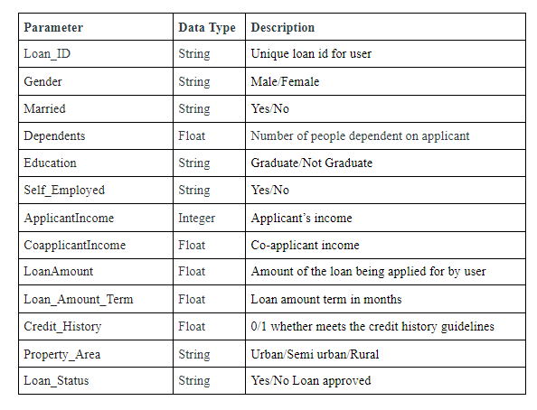
Data Parameters & Data Types

Slide 8
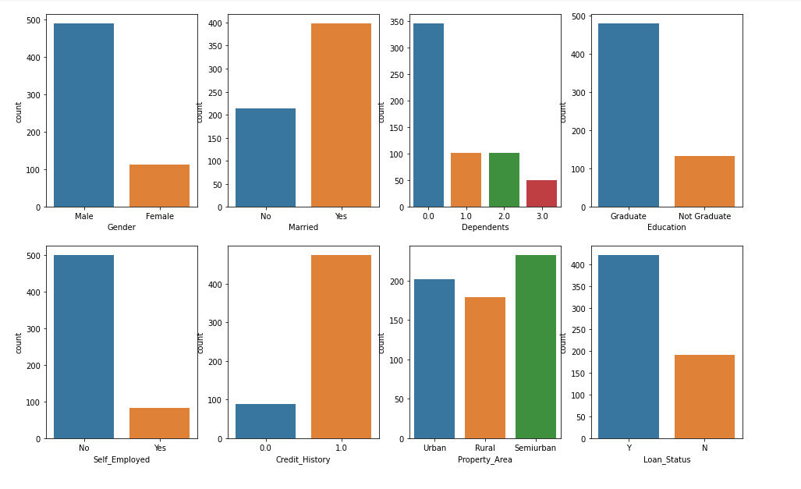
Data Exploration
Categorical Data Visualization

Slide 9
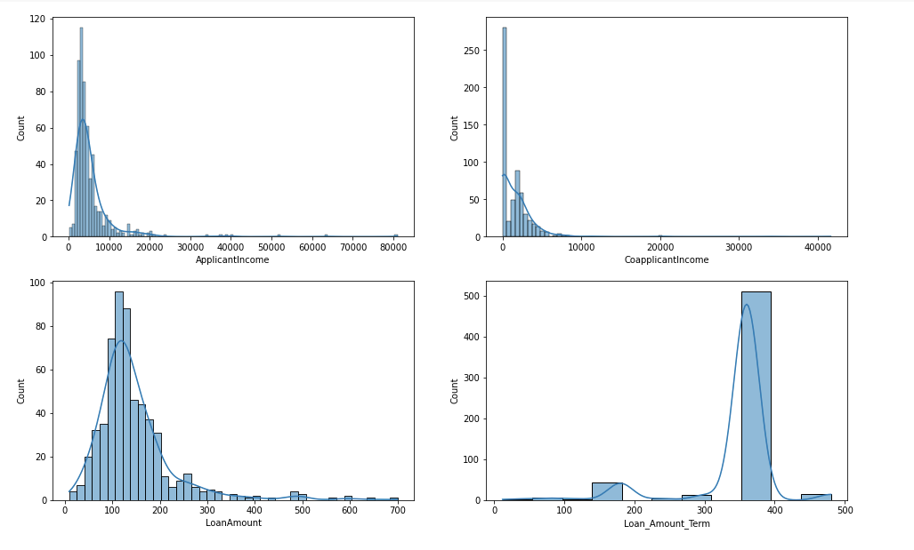
Data Exploration
Continuous Data Visualization

Slide 10
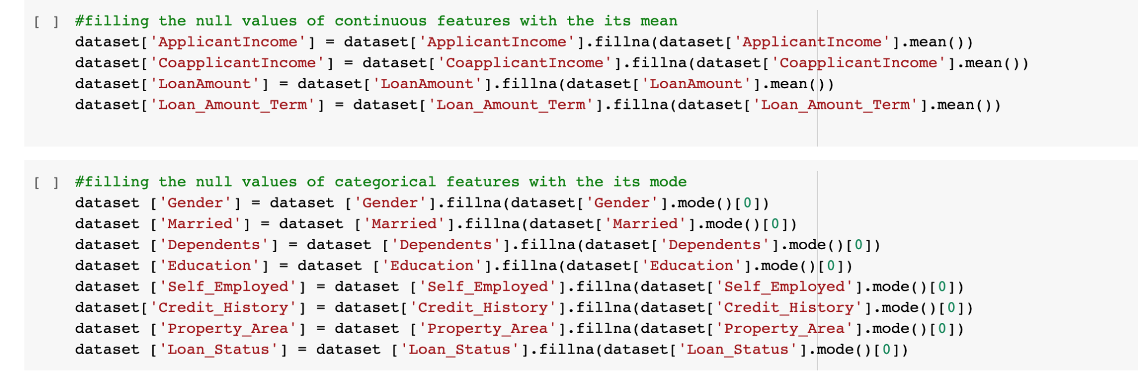
Data Cleaning
Continuous data: filling missing data with features mean
Categorical data: filling missing data with features mode

Slide 11
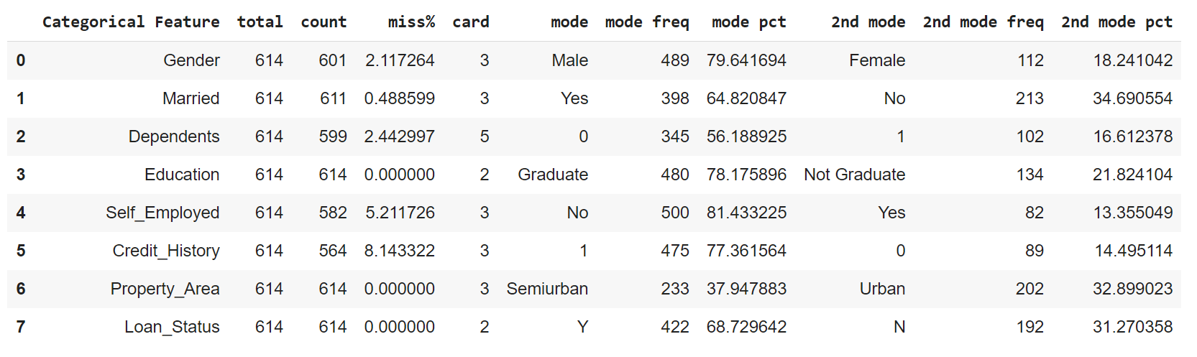
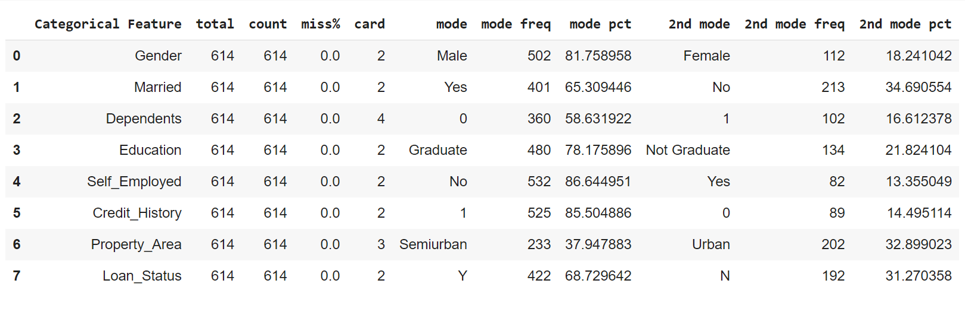
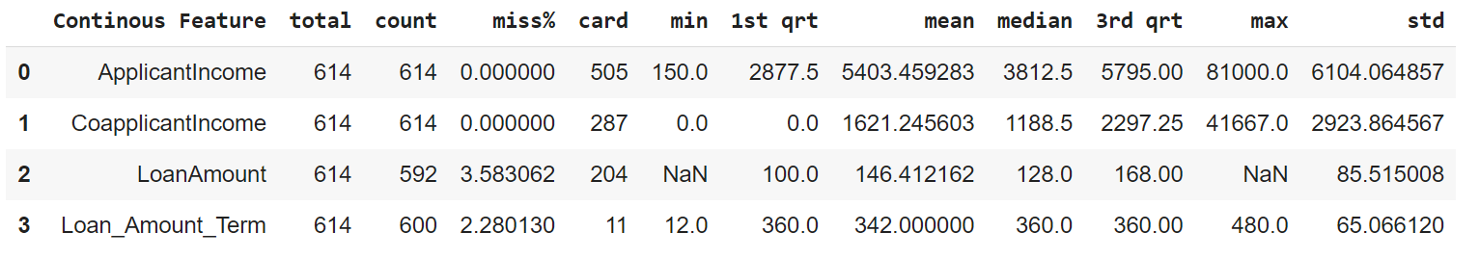
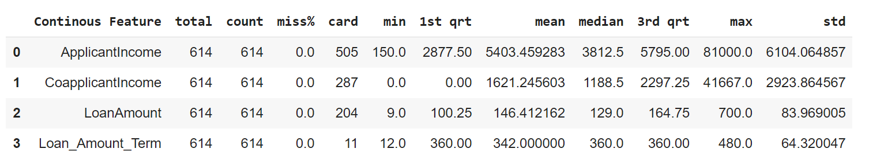
Data Quality Report
Before cleaning
After cleaning

Slide 12
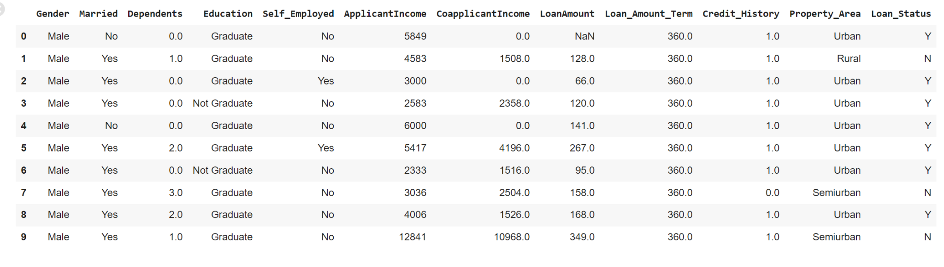
Data Before Cleaning

Slide 13
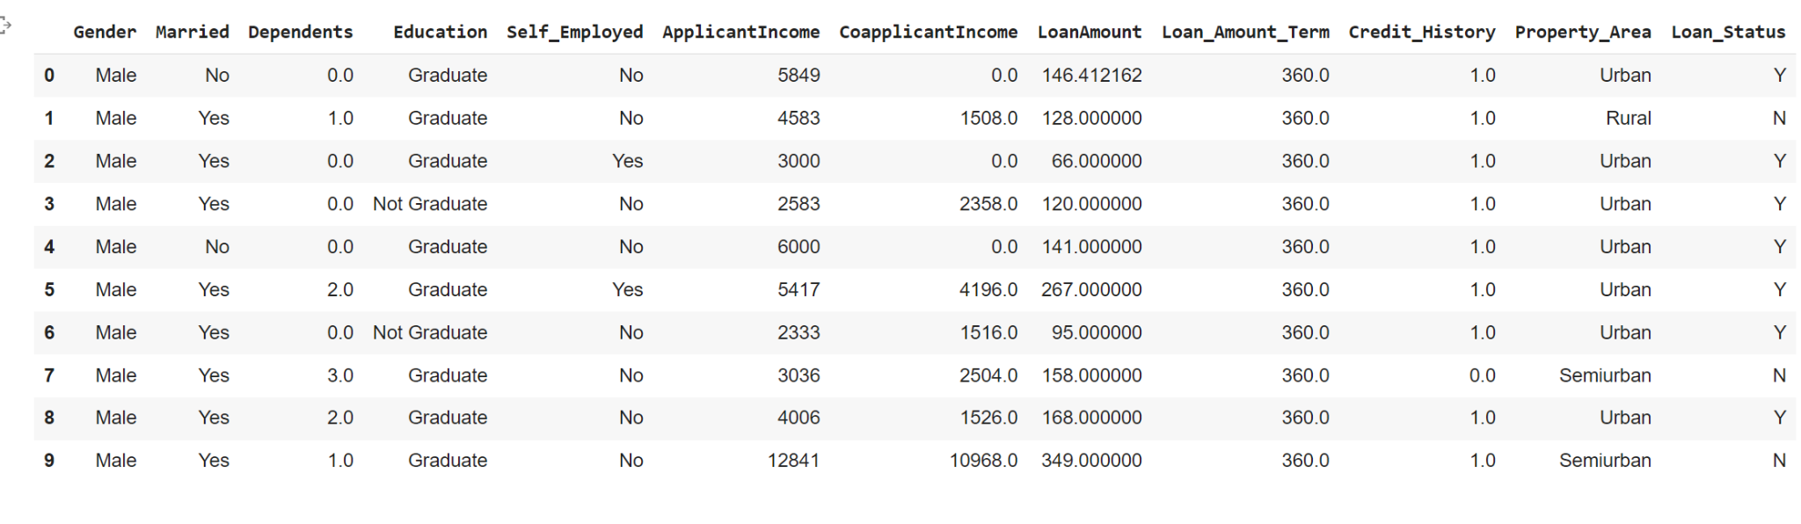
Data After Cleaning (Analytical Base Table)

Slide 14
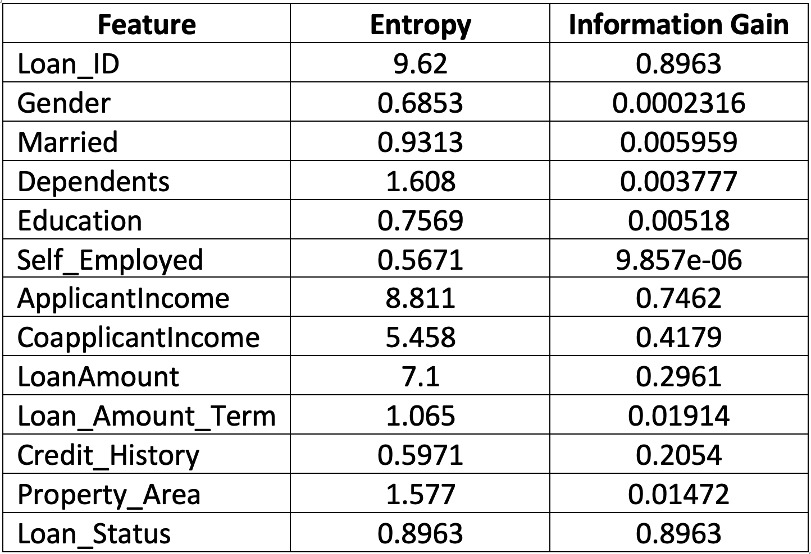
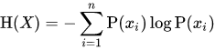
Information Gain
SHANNON ENTROPY
Loan_ID: Will Not be Included in modeling even Though have HIGH INFORMATION GAIN as doesn’t have any effects on target feature.

Slide 15
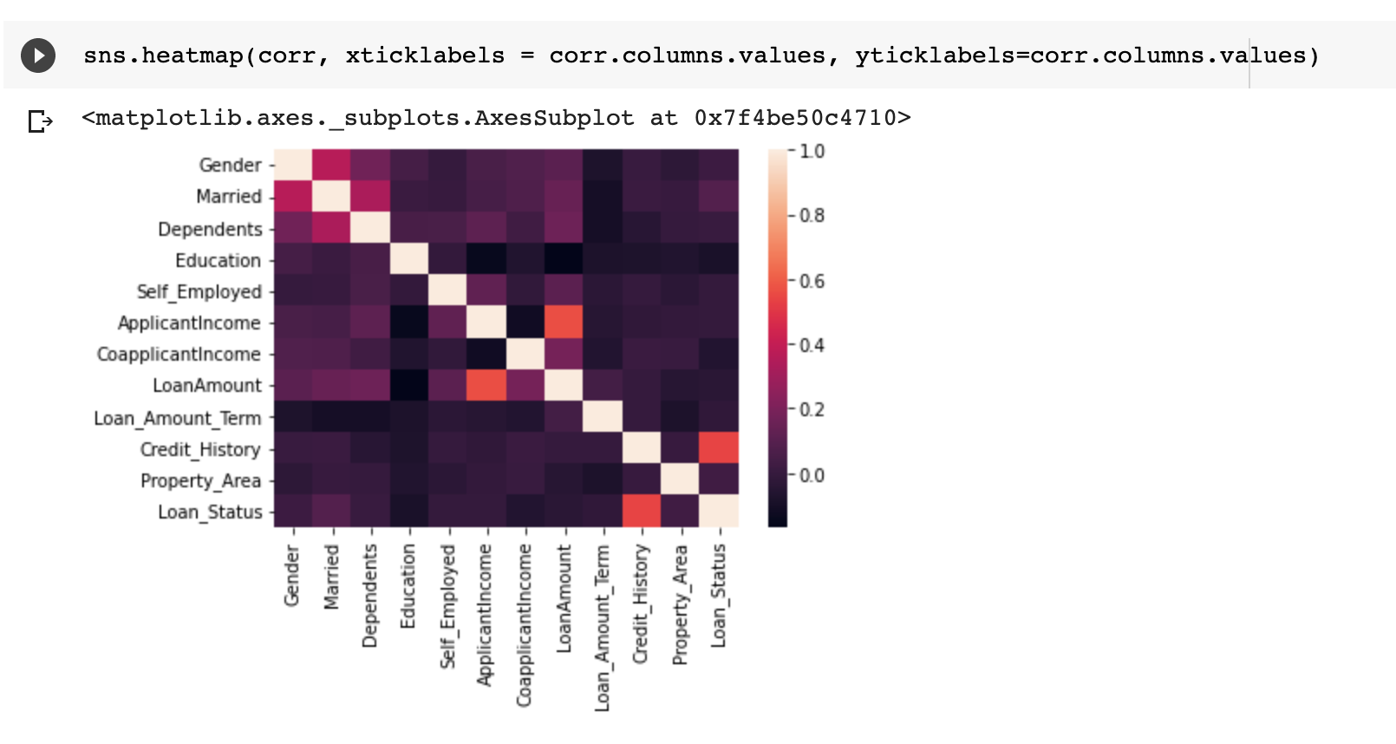
Correlation Heat Map

Slide 16
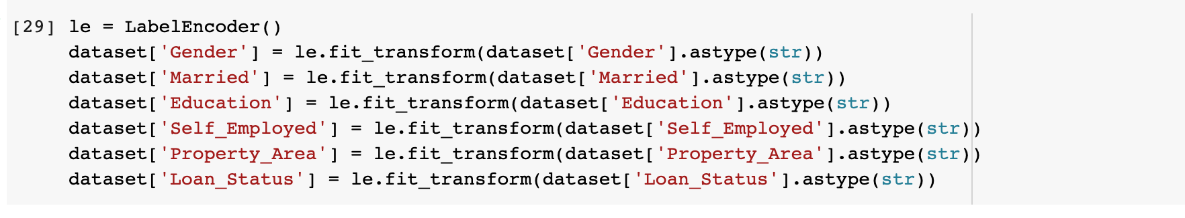
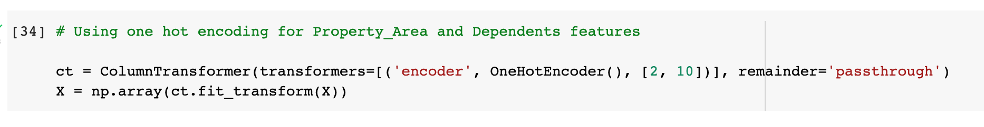
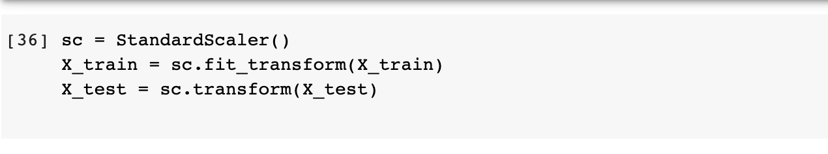
Data Transformation
Label Encoder
Encoding is used to convert categorical variables into numerical values to fit the data to ML models
Label Encoder encode labels with a value 0 or 1
In one hot encoding, each categorical value convert into new column and assign a value of 1 or 0
Feature scaling is used for model to train fast and converge
Standardization is used so that values are centered around mean with unit standard deviation
One Hot Encoding
Feature Scaling

Slide 17
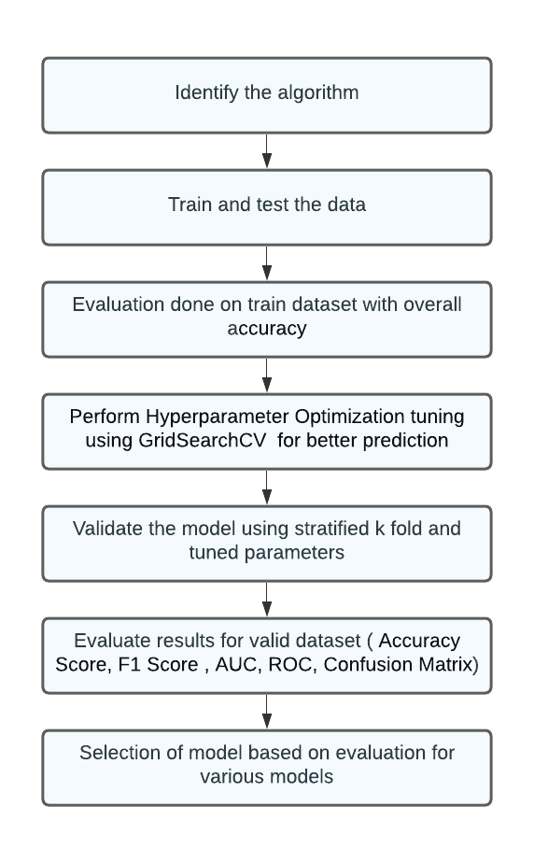
Modeling , Evaluation and Validation

Slide 18
Model Selection
Logistic Regression
Decision Tree
AdaBoost
Classifier
Gradient Boosting

Slide 19
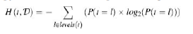
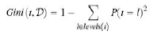
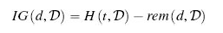
Decision Tree Classifier
Make decisions based on sequences of tests on the descriptive feature values of a query
Data is continuously split into partitions
Nodes : Test for the value of a certain attribute.
Edges/ Branch : Correspond to the outcome of a test and connect to the next node or leaf.
Leaf nodes : Terminal nodes that predict the outcome
Information gain tests computed using either entropy or gini index
Tree pruning can be used to help overfitting problem
Entropy
Gini Index
Information gain
https://towardsdatascience.com/decision-tree-classifier-explained-in-real-life-picking-a-vacation-destination-6226b2b60575
Fundamentals of machine learning for predictive data analytics : algorithms, worked examples, and case studies by John D. Kelleher, Brian Mac Namee, and Aoife DArcy

Slide 20
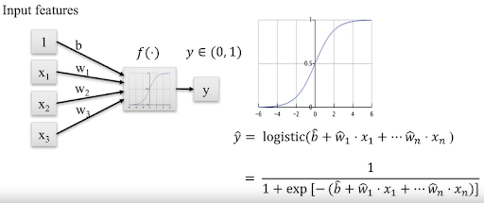
Logistic Regression
Also called logit regression
Predict the probability of target variable
Models the data using sigmoid function
It is a linear regression model but uses sigmoid function instead of linear function
Sigmoid function maps predictions into probabilities
https://towardsdatascience.com/introduction-to-logistic-regression-66248243c148
http://luisevalencia.com/algorithms-logistic-regression/

Slide 21
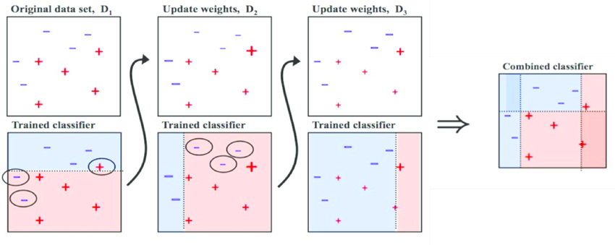
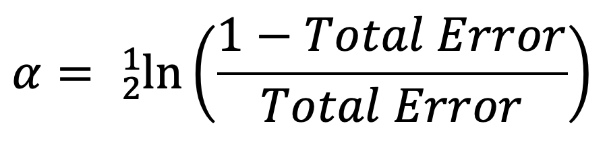
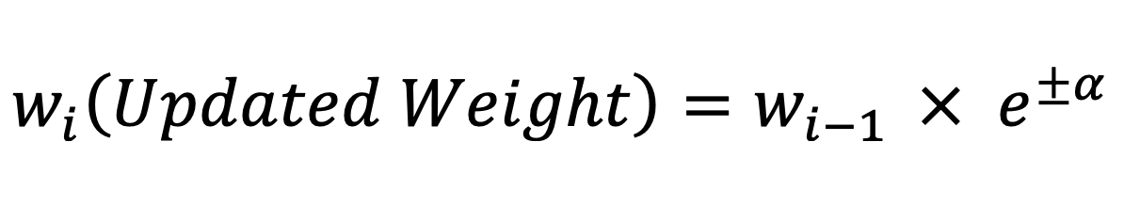
AdaBoost Classifier
It is also called Adaptive Boosting.
As any boosting algorithm it learns from previous weak classifier.
AdaBoost focuses on changing the weight of sample dataset and assign more weights to previously incorrectly classified sample.
It calculates alpha value based on total error.
It uses alpha to update the weights in each Iteration.
https://towardsdatascience.com/understanding-adaboost-for-decision-tree-ff8f07d2851

Slide 22
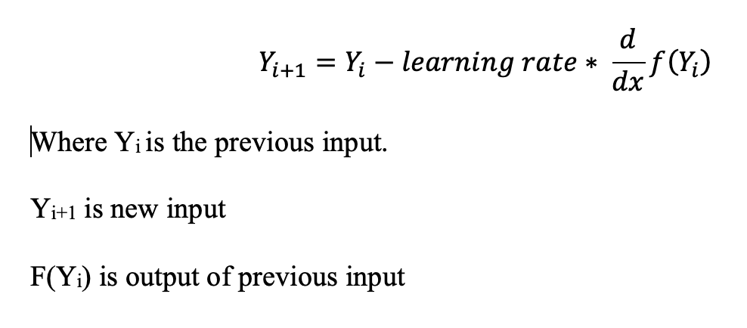
Gradient Boosting Classifier
Boosting technique based on a decision tree classifier.
It uses multiple weak learner model to make prediction.
Does not alter the weights.
Uses Gradient Descent function to optimize the loss of the output.
Uses the optimized output as the input for the next iteration

Slide 23
Model Comparison & Justification
Decision Tree Classifier
Logistic Regression
AdaBoost Classifier
Gradient Boosting Classifier

Slide 24
Model Comparison and Justification
Model | Strengths | Limitations | Justification
Decision Tree | Can work with continuous and categorical data | Complex calculations & sensitive to change in data | The data for project contain categorical and continuous data
 | Easy to interpret the results | Higher time to train
Logistic Regression | Easy to implement, efficient to train | Can lead to overfitting | The data used for project is linear data which should provide good results
 | Can be extended to multinomial regression & uses probabilistic approach | Works only on linearly separable data | Binary target levels

Slide 25
Model Comparison and Justification
Model | Strengths | Limitations | Justification
Gradient Boosting | It has flexibility and provides various hyperparameter tuning options. No data preprocessing is required | The continuous improvement of reduce errors can lead to overfitting. | Used to decrease the bias error
AdaBoost | Less prone to overfitting | Cannot perform well if data is noisy & has outliers | Used to improve the performance of prediction
Note. Both take more computation time

Slide 26
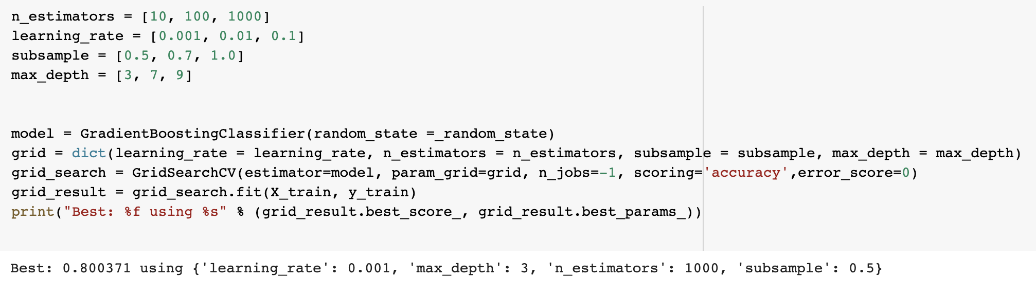
Hyper-parameter Optimization
It refers to automatic tuning of hyper-parameters.
Allows model to maximize model performance by finding best hyper-parameters.
Implemented using GridSearchCV method provided by scikit-learn library.
Defining parameters values
Passing parameters and it’s values to a dictionary
Passing Dictionary as parameter to GridSearchCV Method
Getting best parameters

Slide 27
Hyperparameter Optimization
Model | Parameters | Tuned Parameters
Decision Tree | criterion=["gini", "entropy"] splitter = ["best", "random"] max_features = ["auto", "sqrt", "log2"] | Criterion = gini splitter = best max_features = auto
Logistic Regression | solvers = ['newton-cg', 'lbfgs', 'liblinear'] penalty = ['l2'] c_values = [100, 10, 1.0, 0.1, 0.01] | solver = newton-cg penalty = l2 c_values = 100
AdaBoost Classifier | n_estimators = [10, 50, 100, 500, 1000, 5000] algorithm = ['SAMME', 'SAMME.R'] learning_rate = [0.0001, 0.001, 0.01, 0.1, 1] | n_estimators = 10 Algorithm = SAMME learning_rate = 0.0001
Gradient Boosting | n_estimators = [10, 100, 1000] learning_rate = [0.001, 0.01, 0.1] subsample = [0.5, 0.7, 1.0] max_depth = [3, 7, 9] | n_estimators = 1000 learning_rate = 0.001 subsample = 0.5 max_depth = 3

Slide 28
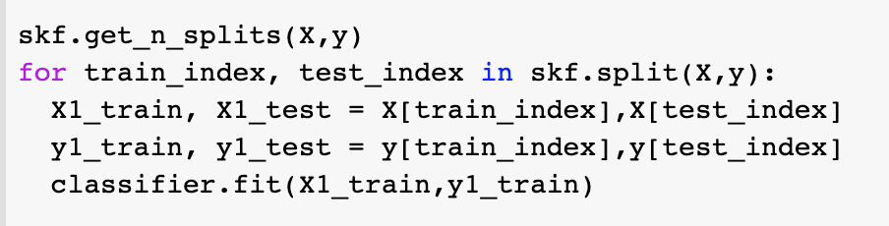
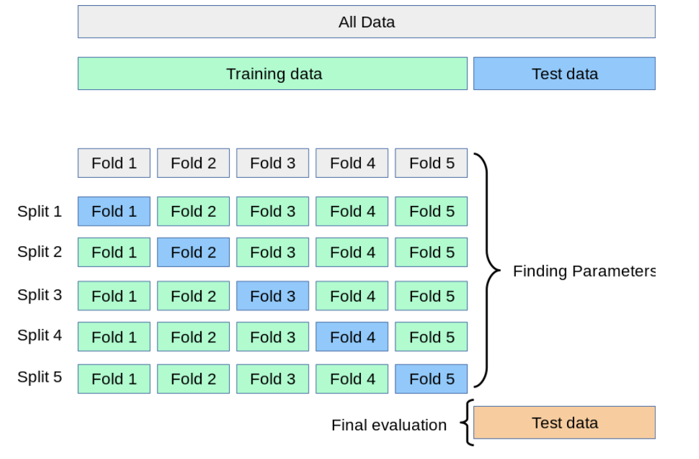
Stratified K-Fold Validation
Dataset is split into sample sets by providing indices for training and testing dataset.
A sample training set is created and used to train in each iteration.
Number of iteration depends on the value of K.
Stratified K-Fold preserves the percentage of samples for each class reducing dataset bias.
Method is provided by scikit-learn library.
https://scikit-learn.org/stable/modules/cross_validation.html

Slide 29
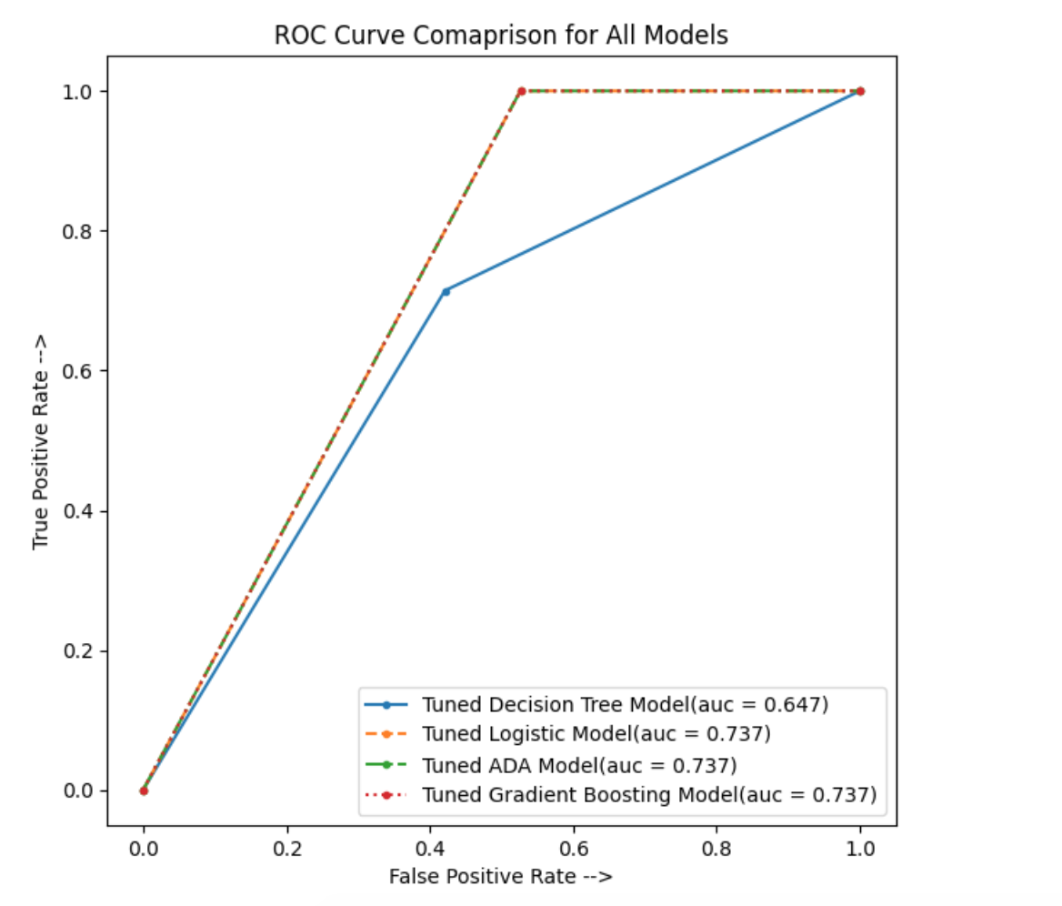
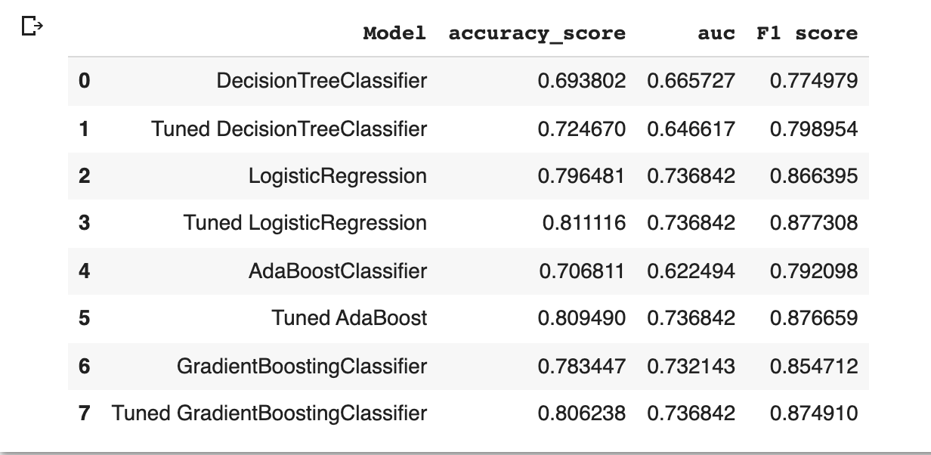
Model Evaluation
Tuned Logistic Regression model has high accuracy, F1 score

Slide 30
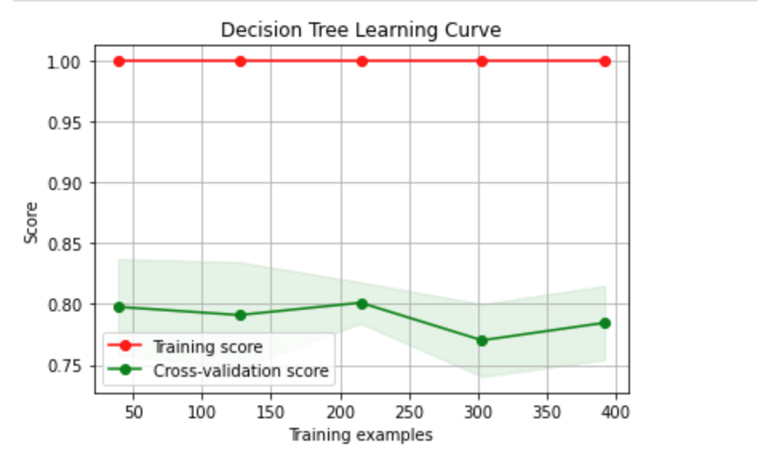
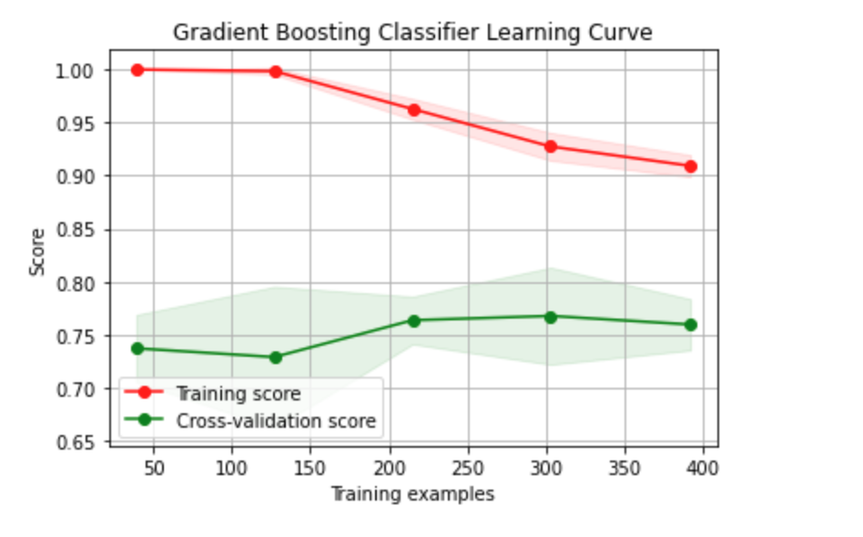
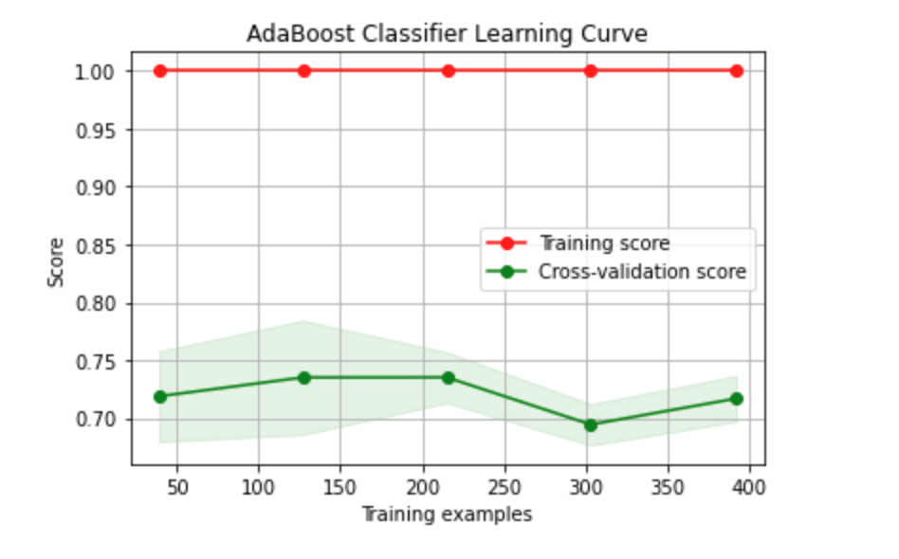
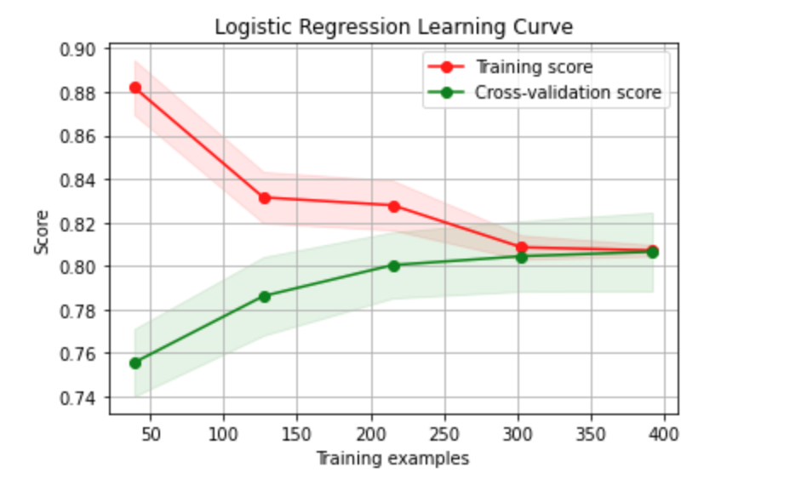

Slide 31
Conclusion
Tuned Logistic Regression is the best model among all the models that were proposed.
Outperformed all the other model in all the evaluation metrics after Stratified K- Fold Validation.

Slide 32
Future Work
Increase the accuracy of models above 90 percent.
Use Deep learning models to classify.
Create an end-to-end data pipeline that can take real-time data and classify it.
Create an interface using which banks and customers can use the model.

Slide 33
References
Chatterjee, D. (2019). Loan Prediction Problem Dataset. Kaggle. https://www.kaggle.com/altruistdelhite04/loan-prediction-problem-dataset/metadata
Mukid, M. A., Widiharih, T., Rusgiyono, A., & Prahutama, A. (2018, May). Credit scoring analysis using weighted k nearest neighbor. In Journal of Physics: Conference Series (Vol. 1025, No. 1, p. 012114). IOP Publishing.
Odegua, R. (2020). Predicting Bank Loan Default with Extreme Gradient Boosting. arXiv preprint arXiv:2002.02011.
Vimala, S., & Sharmili, K. C. (2018). Prediction of loan risk using naive bayes and support vector machines. In Int Conf Adv Comput Technol (ICACT) (Vol. 4, No. 2, pp. 110-113).
S. Sreesouthry, A. Ayubkhan, M. Mohamed Rizwan, D. Lokesh, K. Prithivi Raj. (2021). Loan Prediction Using Logistic Regression in Machine Learning. Annals of the Romanian Society for Cell Biology, 2790 –. Retrieved from https://www.annalsofrscb.ro/index.php/journal/article/view/2818
Kelleher, J., & Namee, B., & D’Arcy, A. (2015). Fundamentals of Machine Learning for Predictive Data Analytics. The MIT Press.
Eweoya, I. O., Adebiyi, A. A., Azeta, A. A., & Azeta, A. E. (2019, August). Fraud prediction in bank loan administration using decision tree. In Journal of Physics: Conference Series (Vol. 1299, No. 1, p. 012037). IOP Publishing.

Slide 34
Thank You!

